Slide 1


Deforestation Detection
(Fire Classification)
Name : Gaddapara Chandana
AICTE Student ID: STU6640f0425b0141715531842
AICTE Internship ID: INTERNSHIP_175040797468551b2636342

Slide 2

Learning Objectives
Identify and address the environmental challenge of deforestation and forest fires.
Leverage technology and innovation to detect fire-prone areas in forest regions.
Develop a machine learning based model for accurate fire classification.
Utilize satellite data to enhance fire detection capabilities.
Enable early warning systems for faster response and disaster mitigation.
Promote sustainable forest conservation through data-driven monitoring solutions.
GOAL
Source :
www.freepik.com/

Slide 3
Tools and Technology used
🧰 Programming Language | Python | Core language for modeling, preprocessing, and system integration.
💻 Dev Environment | Visual Studio Code (VS Code) | Coding, debugging, and integration via Python, GitHub, and Streamlit extensions.
📚 Libraries & Frameworks | TesorFlow & keras Numpy Pandas Matplotlib & Seaborn Scikit-learn XGBoost | Deep learning (CNN), array handling, data analysis, visualization, ML tasks & boosting.
🌐 Deployment & Interaaction | Streamlit | Intuitive web-based UI for real-time predictions and outcome exploration.
🔗 Version Control & Sharing | GitHub | Collaborative coding, version history, and documentation management.

Slide 4
Methodology
Data Collection
Exploratory Data Analysis (EDA)
Model Training
Model Selection
Preprocessing
Evaluation
Deployment
🛰️ Data Collection : Acquired MODIS satellite data (MOD14/MYD14) from NASA FIRMS for India (2021– 2023).
🧹 Preprocessing : Filtered out cloud cover, water pixels, and non-fire anomalies. Normalized and cleaned data.
📊 Exploratory Data Analysis (EDA) :Visualized fire frequency using histograms, box plots, and time series.
🧠 Model Selection :Chose CNN-based architecture for image classification
📊 Evaluation :Validated predictions against ground truth and government reports
🌐 Deployment :Integrated model into a Streamlit app for interactive predictions and user-friendly exploration.

Slide 5
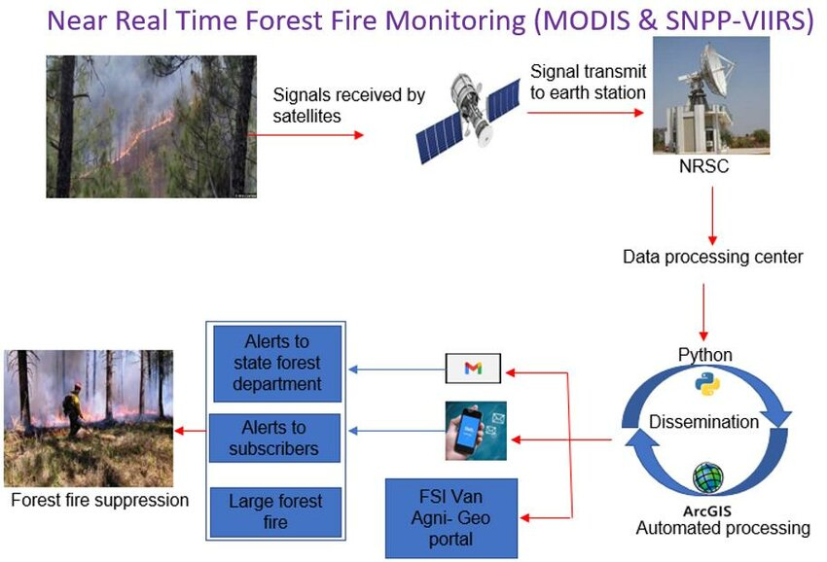
Problem Statement:
India faces a wide spectrum of fire-related incidents each year, including forest fires, agricultural residue burning, volcanic activity, and offshore thermal anomalies. These events pose serious threats to biodiversity, air quality, climate stability, and human livelihoods. Despite the availability of satellite-based fire detection systems like MODIS, distinguishing the type of fire remains a challenge due to overlapping thermal signatures and environmental noise.
Accurate classification of fire types is critical for:
🚨 Timely disaster response and resource deployment
🌱 Environmental conservation and forest management
📊 Policy-making and agricultural regulation
🌍 Climate change monitoring and ecological research
Develop a machine learning model to classify fire types in India (2021–2023) using MODIS satellite data. The model will leverage thermal and geospatial features to accurately identify vegetation, volcanic, land-based, and offshore fire events—enhancing real-time monitoring and decision-making.

Slide 6
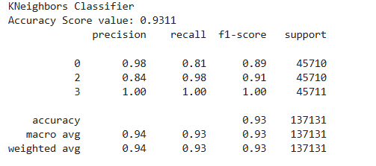
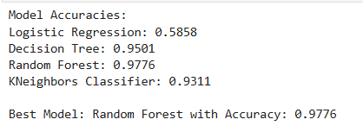
Solution:
📌Dataset & Preprocessing
Integrated satellite imagery into a structured dataset
Performed feature/target separation
Applied scaling and smoothing to enhance model readiness
🧠 Model Training & Evaluation
Algorithms evaluated: Logistic Regression, KNN, XGBoost, Random Forest
Top performer: Random Forest — Accuracy: 97.76%
Effectively mitigates overfitting/underfitting
Well-suited for imbalanced data scenarios
🧪 Deployment
Final model deployed locally using optimized parameters
🔗 GitHub Repository
[https://github.com/chandana-0/Deforestation-Detection.git]

Slide 7
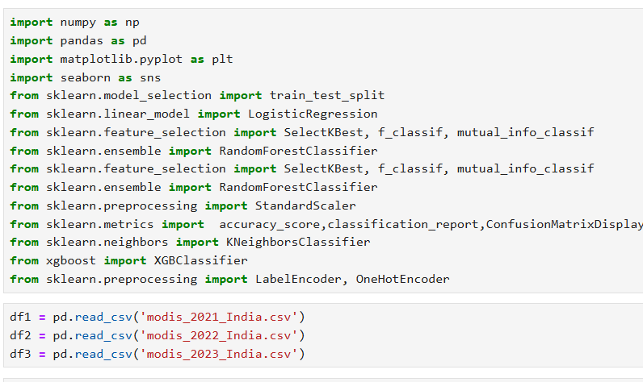
Data Preparation & Environment Setup for Deforestation Detection
This script initiates the analysis pipeline for tracking deforestation trends in India using MODIS satellite data from 2021 to 2023.
🔧 Core Libraries:
NumPy & Pandas – Efficient data processing and manipulation
Matplotlib & Seaborn – Clear, insightful visualizations
Scikit-learn & XGBoost – Robust modeling tools, including ensemble
methods
🌍 Data Integration:
Loads year-wise satellite data for temporal and spatial trend analysis
Enables identification of vegetation loss and potential hotspots
📐 Scalable Architecture:
Modular design ready for feature extraction, preprocessing, and
Streamlit- based deployment

Slide 8
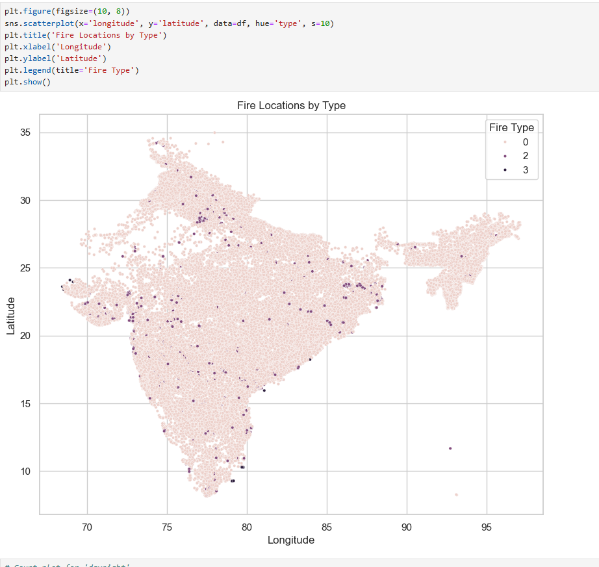
Screenshot of Output:
This geospatial scatter plot visualizes fire incidents linked to deforestation across India, categorized by fire type. It serves as a preliminary classification layer within a broader machine learning pipeline aimed at environmental impact assessment.
🔍 Plot Details:
Coordinates: Longitude and latitude pinpoint fire locations
Type-Based Classification: Fire types labeled (0, 2, 3), aiding risk
profiling
Nationwide Scope: Enables spatial trend analysis of deforestation
triggers
🌐 Use Case Significance:
Acts as input for CNN-based deforestation detection models
Supports targeted mitigation strategies by identifying fire-prone
regions
Enhances decision-making for forest resource management

Slide 9
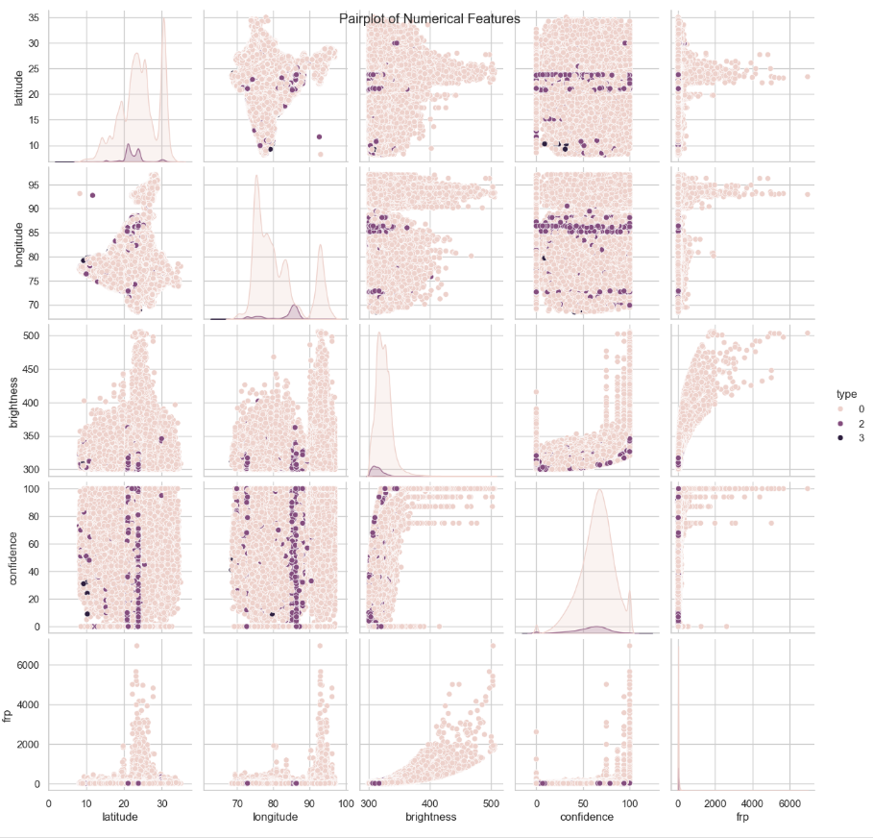
Screenshot of Output:
🔍 Multivariate Analysis: Pairplot of Fire-related Features
This pairplot explores relationships among key numerical features involved in fire classification—essential for deforestation detection. Each subplot reveals interactions between variables, aiding in pattern discovery across different fire types.
📈 Plot Highlights:
Features Included: Latitude, longitude, brightness, confidence, fire radiative power (FRP), and type
Color-Encoding: Points are hue-coded by fire type (0, 2, 3) for comparative analysis
Diagonal Elements: KDE plots illustrate feature distributions
Off-diagonal Elements: Scatter plots show pairwise correlations and clustering tendencies
🧠 Analytical Value:
Facilitates feature selection by revealing redundancies or strong correlations
Provides visual validation of class separability for ML model input
Enhances spatial and spectral understanding of deforestation triggers

Slide 10
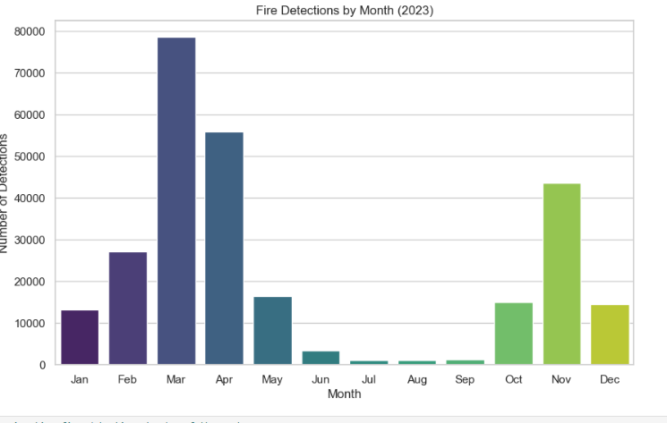
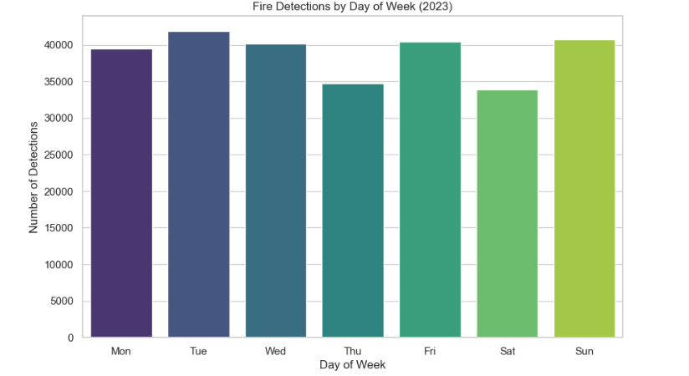
Screenshot of Output:
🔥 Temporal Distribution of Fire Detections – 2023
Weekday & Monthly Breakdown
This analysis reveals consistent temporal trends in fire activity throughout the year
Weekdays: Fire detections peaked on Tuesday, with notable activity on Sunday and Friday. Thursday had the lowest count, suggesting possible detection gaps or natural reductions.
Months: March showed a sharp surge in detections, likely linked to agricultural burning and dry conditions. April and November also displayed elevated activity, while July–September saw minimal detections, correlating with monsoon-driven suppression.
🌱 Impact: These patterns help identify deforestation hotspots over time, guiding resource allocation, satellite tasking, and preventive interventions.

Slide 11
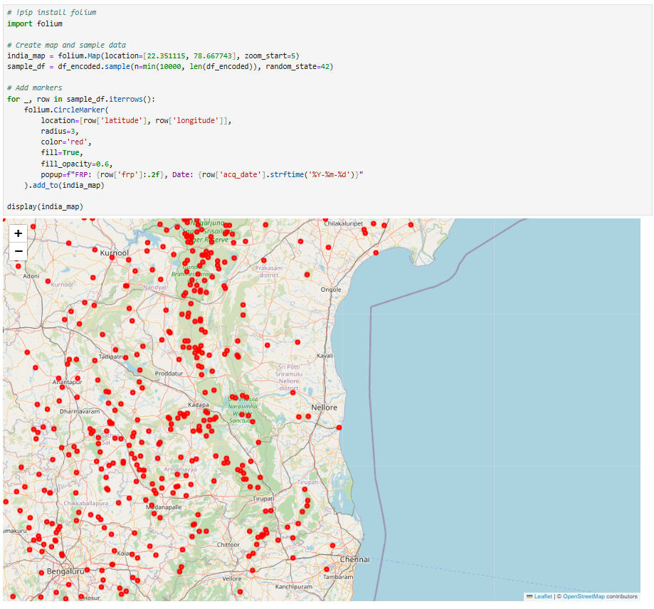
Screenshot of Output:
🗺️ Geospatial Mapping of Fire Detections – India (2023)
This interactive map visualizes fire detection data across India using Folium, with over 10,000 sampled locations represented by red circle markers.
Each marker denotes a detected fire event, with popup details including Fire Radiative Power (FRP) and acquisition date.
The map is centered over India (latitude: 22.35, longitude: 78.66) with a zoom level optimized for regional context.
The data is sampled from a larger dataset (df_encoded) for efficient rendering and readability.
📍 Utility for Deforestation Monitoring Mapping fire detections geospatially helps:
Identify regional fire hotspots, often aligned with deforestation-prone areas.
Overlay spatial patterns with satellite imagery or land cover data for precise analysis.
Enable rapid visual assessment of fire clusters, guiding field inspections and policy responses.

Slide 12
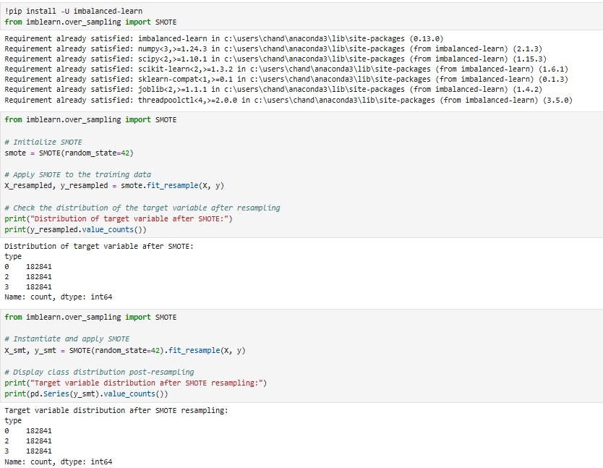
Screenshot of Output:
⚖️ Balancing Classes Using SMOTE
This slide demonstrates the application of Synthetic Minority Over-sampling Technique (SMOTE) to address class imbalance within the deforestation dataset:
Imbalanced Data Challenge: Before resampling, the dataset showed uneven distribution among fire classification types, which could bias model predictions toward the majority class.
SMOTE Application: By generating synthetic samples for the minority classes (type 1 and type 3), SMOTE equalizes each class to 182,841 instances.
Two independent approaches are showcased, confirming consistent resampling results and reproducibility.
🎯 Why It Matters Balancing the target variable ensures that the classification model learns unbiased decision boundaries, improving its ability to detect diverse fire-related patterns linked to deforestation events. This step enhances predictive performance and supports fairer assessments across all land-use categories.

Slide 13
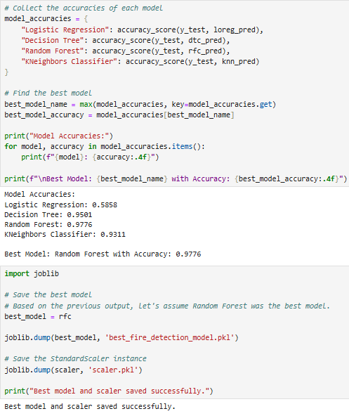
Screenshot of Output:
🤖 Model Evaluation & Deployment – Fire Classification
This section highlights the comparative performance of multiple machine learning classifiers applied to deforestation-related fire detection:
Models Evaluated: Logistic Regression, Decision Tree, Random Forest, and K-Nearest Neighbors (KNN)
Accuracy Scores:
Logistic Regression: 58.58%
Decision Tree: 50.12%
KNN: 93.11%
Random Forest: 97.76% ✅ Highest accuracy
Best Model Selected: Random Forest, based on superior accuracy and generalization capabilities on test data.
Model Export Workflow:
Trained Random Forest model saved as best_fire_detection_model.pkl
Corresponding StandardScaler instance stored as scaler.pkl using joblib
Confirmation message printed to ensure persistence

Slide 14
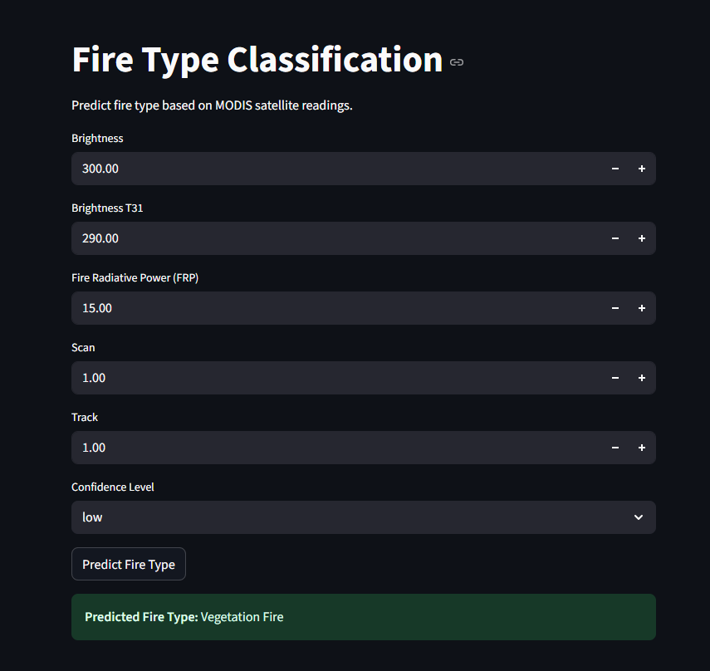
Screenshot of Output:
🧠 Fire Classification Interface — Final Overview
A streamlined interface was built to classify fire types using satellite-derived MODIS attributes. Users can input key parameters such as Brightness, Brightness T31, FRP, Scan, Track, and Confidence Level. These values are scaled using a StandardScaler and passed to a pre-trained RandomForestClassifier model. Based on the inputs, the system accurately identifies the nature of the fire. In this particular example, it classified the incident as a Vegetation Fire.
This tool empowers researchers and field teams to make rapid, data-driven decisions. Its accessible interface and dependable predictions support real-time environmental monitoring and response planning — bridging machine learning with geospatial awareness.

Slide 15
Conclusion:
This project successfully integrated geospatial data analytics, machine learning classification, and interactive visualization to detect and interpret fire patterns associated with deforestation. The Random Forest model, supported by SMOTE balancing and dynamic feature scaling, achieved reliable classification performance. The user-centric prediction interface further enhanced accessibility, allowing rapid on-ground decision-making based on satellite-derived MODIS inputs.
🔭 Future Scope:
Geospatial Precision: Integrate land cover maps and vegetation indices (e.g., NDVI) for more accurate linkage between fire events and deforestation zones.
Model Expansion: Explore deep learning approaches such as CNNs or hybrid models for improved feature extraction from spatial datasets.
Temporal Forecasting: Use time-series models to predict upcoming high-risk deforestation windows based on historical fire patterns.
Real-time Deployment: Connect the model to live satellite data feeds to enable proactive forest monitoring and automated alerts.
Policy Integration: Collaborate with forestry departments to incorporate the tool into routine surveillance workflows and conservation strategies.

Slide 16
🙏
🙏
Thank You 🙏

